Slide 1
Amplitude modulation: theory
Depth of modulation (4×M)
Low frequency (ω₀) modulation envelope
High frequency (ω) carrier sinusoid

Slide 2
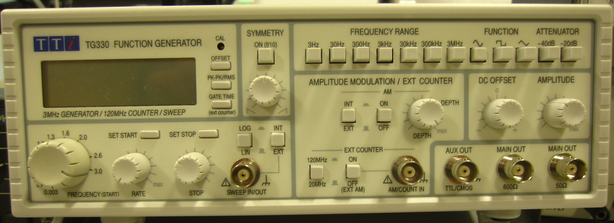
Function generator: amplitude modulation
The modulating function A(t) can be external (from an external generator) or internal. There is special input for the external A(t).

Slide 3
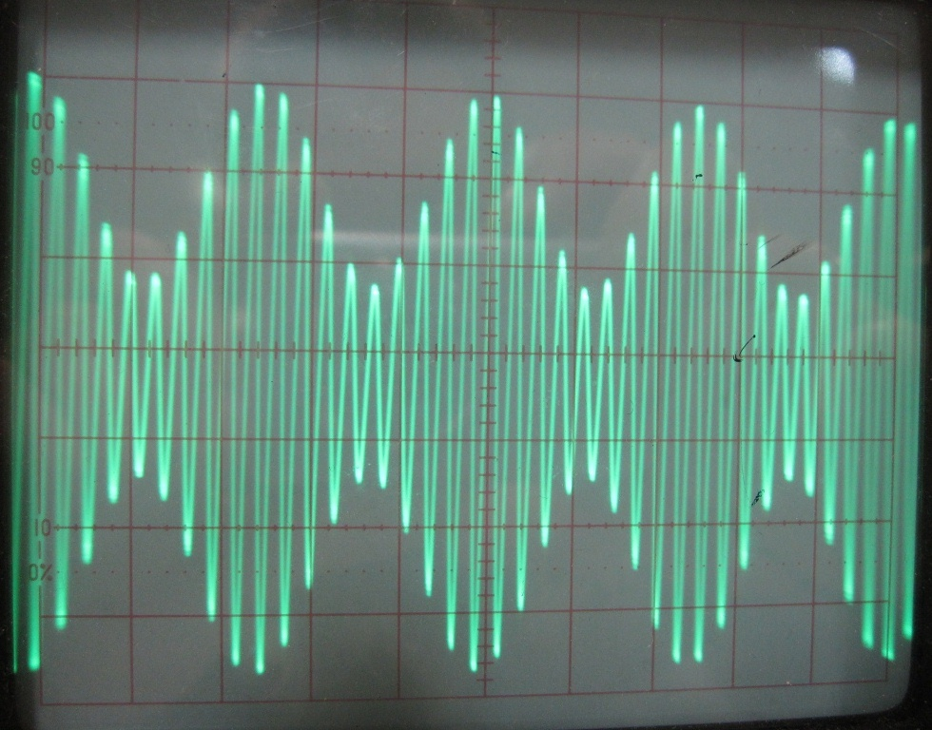
Experiment: amplitude modulation of a sinusoidal signal

Slide 4
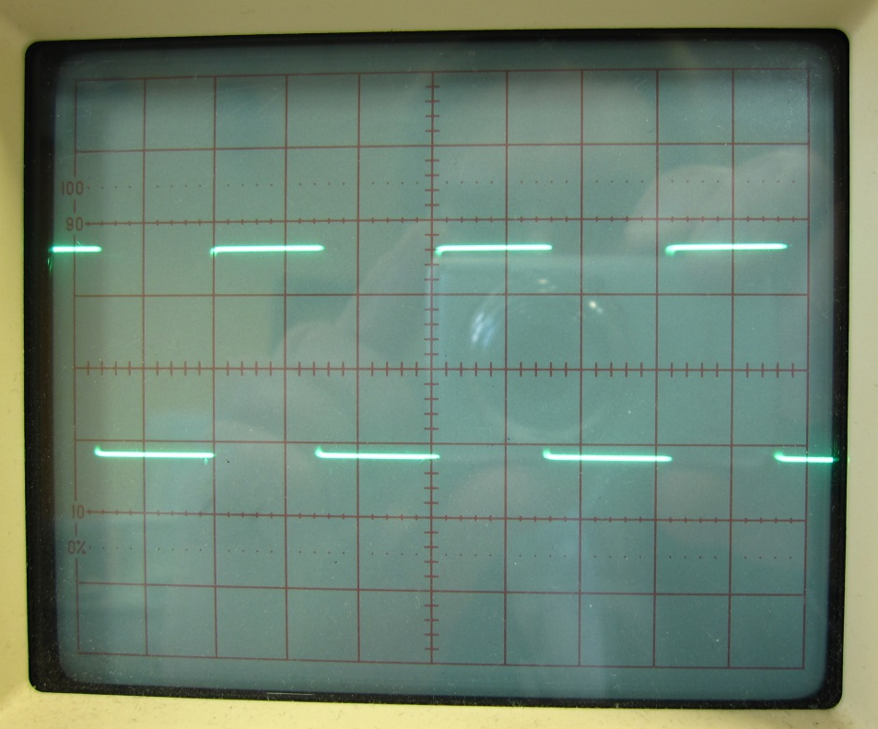
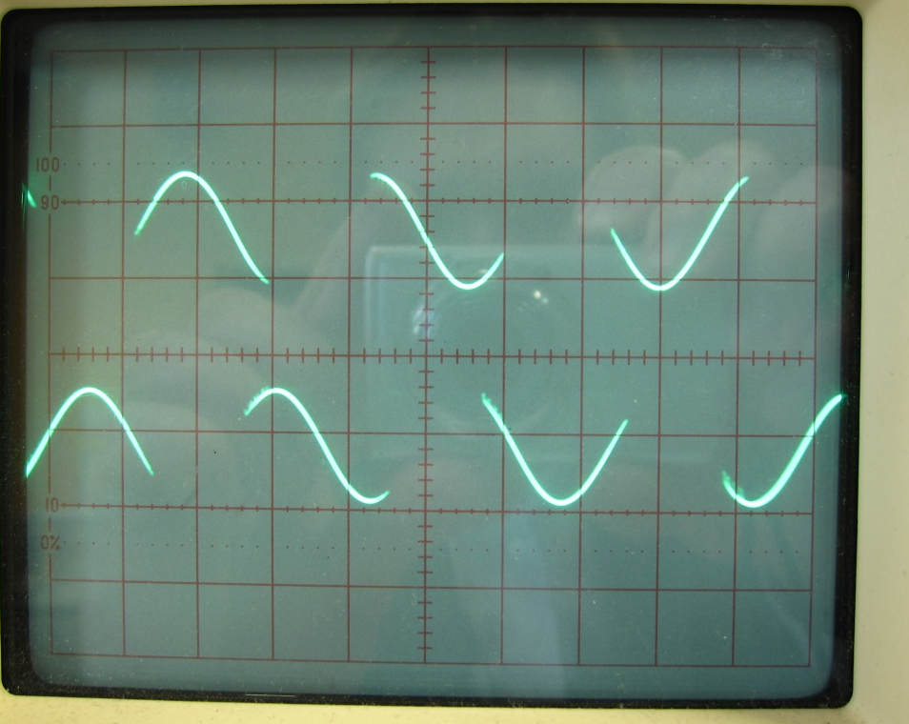
Experiment: amplitude modulation of a square pulse signal

Slide 5
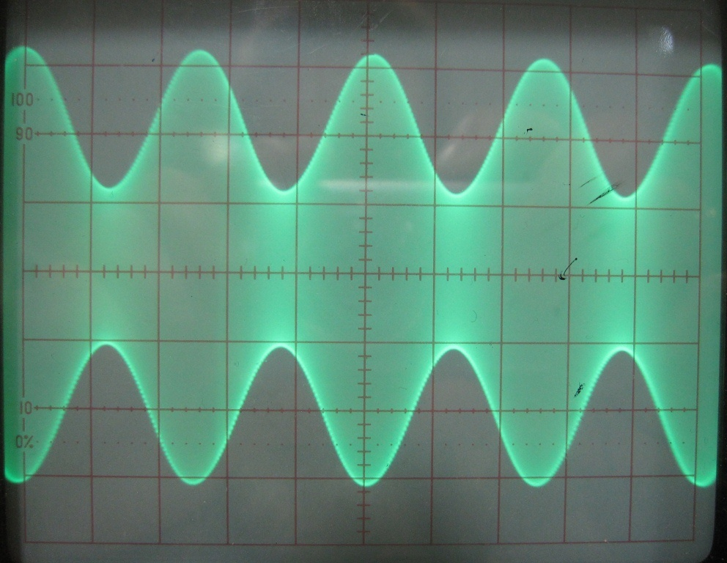
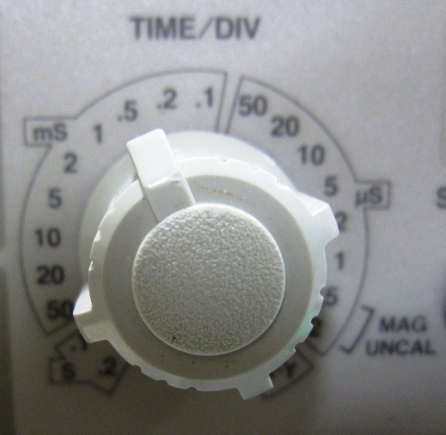
Amplitude modulation: experimental example

Slide 6
Amplitude modulation: experimental example

Slide 7
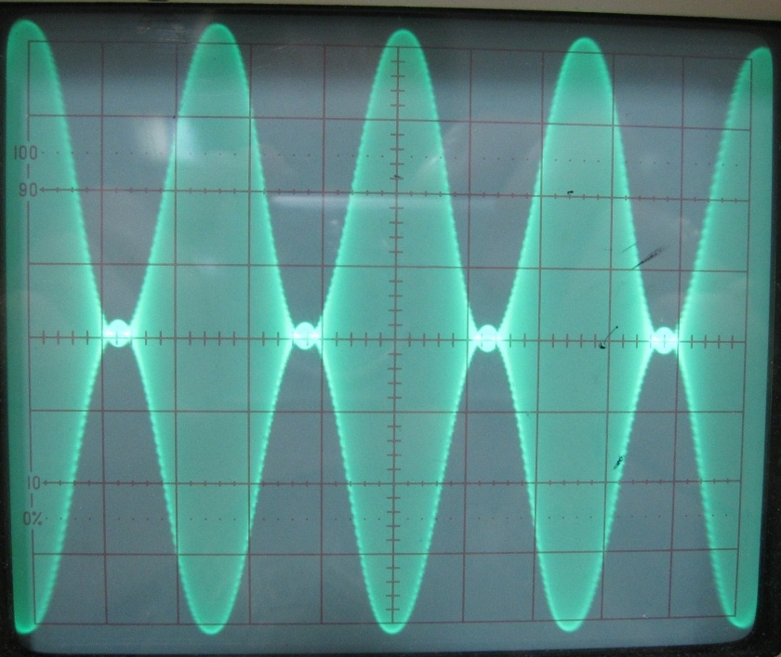
Amplitude modulation: experimental result

Slide 8
Frequency modulation: theory

Slide 9
Function generator: frequency modulation
Start and Stop frequencies,
and scan rate
The modulating function f(t) can be external (from an external generator) or internal (linear or logarithmic). There is special input/output for f(t): the input − for an external f(t), and the output − for the internal LOG and LIN frequency modulation functions.

